Slide 1


Ivan Stepanov
01/06/2024

Slide 2

Outline
Executive Summary
Introduction
Methodology
Results
Conclusion
Appendix

Slide 3
Executive Summary
Summary of methodologies:
Data Collection and Wrangling
Exploratory Data Analysis (EDA)
Interactive Dashboard
Predictive Analysis
Summary of all results:
Data Insights
Model Performance
Dashboard Utility

Slide 4
Introduction
Project Background and Context:
SpaceX has revolutionized the space industry by significantly lowering launch costs through the reuse of the Falcon 9 first stage. While SpaceX offers launches for about $62 million, other providers charge around $165 million, mainly due to the inability to reuse rocket stages. This project aims to leverage data science to predict the landing success of Falcon 9's first stage, providing insights for companies looking to compete with SpaceX.
Problems to Address:
Can we predict the success of Falcon 9's first stage landing?
What factors most influence landing success?
How can these predictions inform competitive strategies?

Slide 5

Section 1

Slide 6
Methodology
Executive Summary
Data collection methodology:
The data was collected from SpaceX API and web scraped from wikipedia
Perform data wrangling
Transforming the raw data
Perform exploratory data analysis (EDA) using visualization and SQL
Perform interactive visual analytics using Folium and Plotly Dash
Perform predictive analysis using classification models
Implemented four machine learning classification algorithms: Logistic Regression, Decision Trees, Support Vector Machine (SVM), and K-Nearest Neighbors (KNN)

Slide 7
Data Collection
The data for this project was collected from two sources: the SpaceX API and web scraping from Wikipedia.
You need to present your data collection process use key phrases and flowcharts
Accessing SpaceX API and
Extract Data. Additionally, HTML content was retrieved from Wikipedia pages
Filter data
for Falcon9
dataset
Identify how
wariables affects
the objetives

Slide 8

Data Collection – SpaceX API
Send GET Request to SpaceX API
Decoding the response content and turning it into a dataframe
SpaceX provides a publicly accessible interface, known as an API (Application Programming Interface), that allows users to retrieve data for their own use.
Constructing data into a dictionary
Exporting the data to CSV file
Filtering dataframe, and replacing missing values
Creating dataframe from the dictionary
GitHub

Slide 9
Data Collection - Scraping
Requesting Falcon 9 launch data from Wikipedia
Creating a Beautiful Soup object from the HTML response
Data from Wikipedia site,extracted from html
Parsing HTML tables to collect the data
Exporting the data to CSV file
Creating a dataframe from the dictionary
Constructing data we have obtained into a dictionary
GitHub

Slide 10
Data Wrangling
Perform EDA and determine training labels
Calculate the number of launches on each site
Calculate the number and occurrence of each orbit
Exporting the data to CSV file
GitHub
Create a landing outcome label from Outcome column
Calculate the number and occurence of mission outcome of the orbits

Slide 11
EDA with Data Visualization
The charts were selected to visually explore different aspects of the SpaceX launch data and derive insights.
1. Flight Number vs. Payload Mass: To observe trends over time, distinguishing between successful and unsuccessful ﬂights.
2. Flight Number vs. Launch Site: To compare launch distributions across sites, highlighting success outcomes.
3. Payload vs. Launch Site: To analyze payload distribution and its impact on launch outcomes across sites.
4. Success Rate of Each Orbit: To compare success rates across different orbit types.
5. Flight Number vs. Orbit: To examine orbit success rates over time.
6. Payload Mass vs. Orbit: To explore the relationship between payload mass and orbit success.
7. Mean Success Rate by Year: To visualize trends in launch success rates over time.
GitHub

Slide 12
EDA with SQL
There are 4 distinct landing sites: CCAFS LC-40, VAFB SLC-4E, KSC LC-39A, CCAFS SLC-40
The total payload mass carried by boosters launched by NASA (CRS): 45596 kg
An average payload mass carried by booster version F9 v1.1: 2534.6667 kg
The date when the ﬁrst successful landing outcome in ground pad was achieved: 2015-12-22
The names of the boosters which have success in drone ship and have payload mass greater than 4000 but less than 6000: F9 FT B1022, F9 FT B1026, F9 FT B1021.2, F9 FT B1031.2
There are 100 successful mission outcomes and 1 failure
There are 12 booster versions which have carried the maximum payload mass 15600 kg.
There are 2 records which have failure (drone ship) landing outcome in 2015
In the period from 2010-06-04 to 2017-03-20, there were 9 successful landings on the ground and 5 unsuccessful landings on the drone ship
GitHub

Slide 13
Build an Interactive Map with Folium
In the data visualization process using Folium, various map objects such as markers, circles, and lines were created and added to the map to provide a clear and informative visualization of SpaceX launch data. Here is a summary of each object:
● Markers for launch sites:
- Added markers for each SpaceX launch site to clearly indicate the geographical locations of all launch sites on the map, allowing for easy identiﬁcation and comparison.
● Marked the success/failed launches for each site:
- Added markers for each launch at the respective launch sites, color-coded by success (e.g., green for success, red for failure) to provide a visual representation of the outcome of launches at each site, making it easy to see patterns of success and failure geographically.
● Calculated the distances between a launch site to its proximities:
- Added circles around each launch site to indicate proximity ranges to visually represent areas around each launch site, helping to understand the geographical spread and potential impact areas.
- Added lines between the launch sites and the nearest highway, railway, city have been added to indicate distances to provide a visual assessment of the distances from the launch sites to signiﬁcant objects,
GitHub

Slide 14
Build a Dashboard with Plotly Dash
Added dropdown menu for "All sites" and individual launch sites to provide ﬂexibility in the data being viewed, allowing users to focus on overall trends or drill down into speciﬁc launch sites for detailed analysis.
● Added a pie chart for the selected launch site (there is an option for all sites) to give a clear visual representation of the success ratio, helping users quickly grasp the performance of SpaceX launches either in aggregate or at speciﬁc sites.
● Payload Mass Range Slider: Added a range slider for payload mass from 0 to 10,000 kg to enable detailed analysis of how payload mass affects launch success, allowing users to investigate speciﬁc payload ranges and their corresponding outcomes.
● Added a scatter plot for Payload Mass vs Success that updates dynamically based on the selected launch site and payload mass range, with different colors for different booster versions. This helps in visually exploring the relationship between payload mass and launch success, and understanding how different factors inﬂuence the success of launches.
GitHub

Slide 15
Predictive Analysis (Classification)
Creating a Numpy array from the “Class” column
Standardizing the data with StandardScaler
Splitting data into training and testing sets
Finding the model performs best with a highest performance across all evaluation metrics
Developing 4 machine learning classification models: Logistic Regression, SVM, Decision Tree, KNN
Applying GridSearchCV for finding the best parameters of each model
GitHub

Slide 16

Section 2

Slide 17
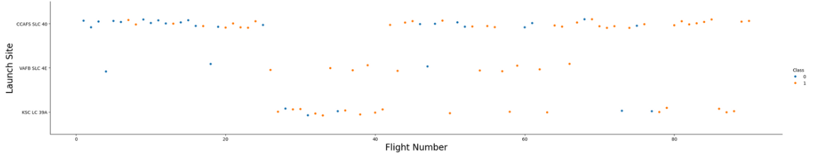
Flight Number vs. Launch Site
Explanation:
● The ﬁrst launches were unsuccessful, while the latest ones are more successful
● The CCAFS SLC 40 launch site has the most launches
● However, VAFB SLC 4E and KSC LC39A have higher success rates

Slide 18
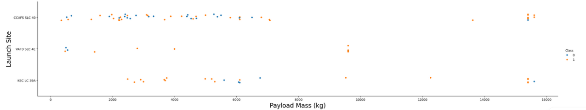
Payload vs. Launch Site
Explanation:
● For each launch site the higher payload mass gives higher success rate
● Most launches with payload mass more than 7500 kg were successful
● KSC LC 39A has also high success rate for payload mass less than 5000 kg

Slide 19
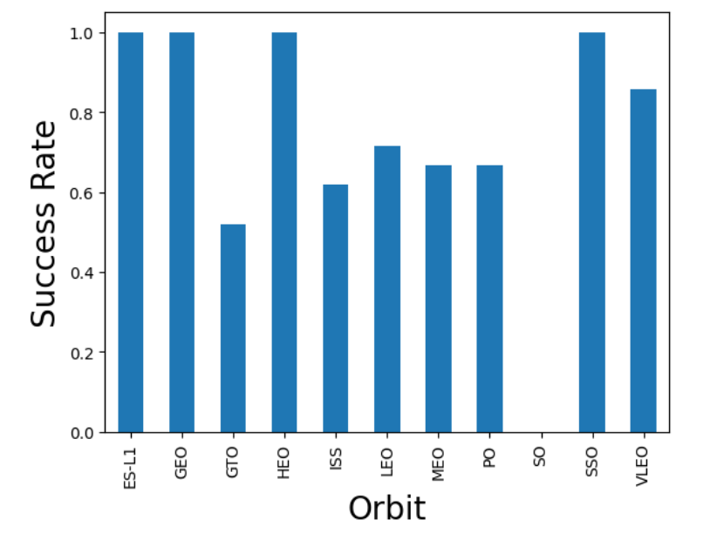
Success Rate vs. Orbit Type
Explanation:
● There are 4 orbits with maximum success rate:
ES-L1, GEO, HEO, SSO
● SO orbit has 0% success rate
● GTO, ISS, LEO, MEO, PO and VLEO orbits
have success rate between 50% and 85%

Slide 20
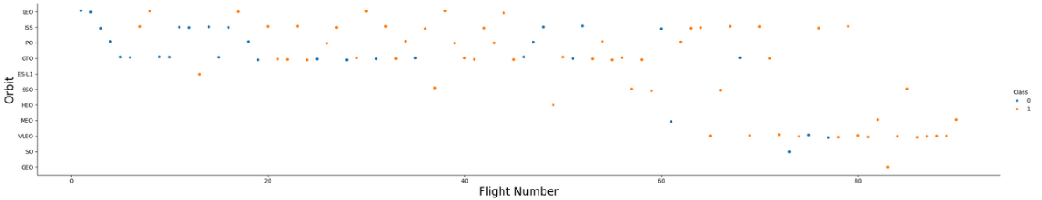
Flight Number vs. Orbit Type
Explanation:
● For LEO orbit the success appears related to the number of ﬂights
● However, for GTO orbit there isn’t no relationship between ﬂight number and success
● We can again see 100% success rate for 4 orbits

Slide 21
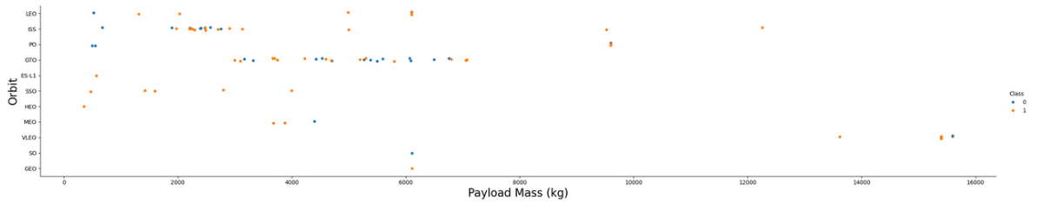
Payload vs. Orbit Type
Explanation:
● Heavy payloads have a negative inﬂuence on GTO orbit and positive on ISS

Slide 22
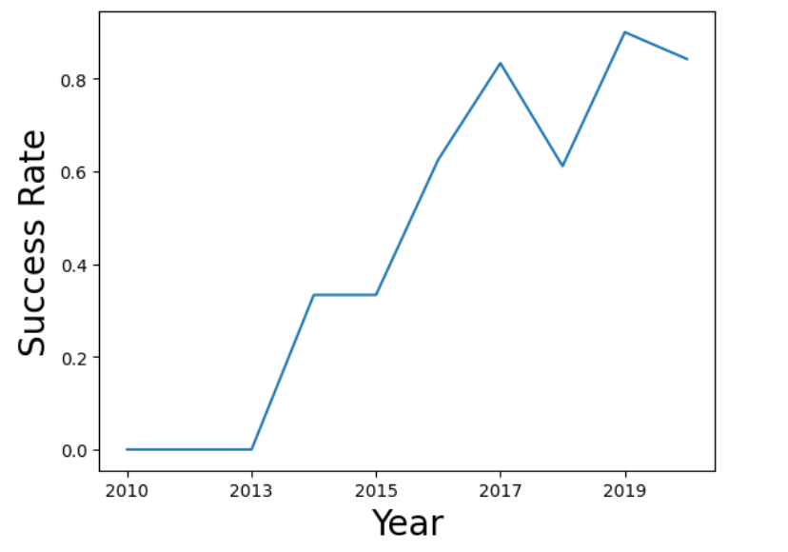
Launch Success Yearly Trend
Explanation:
● The success rate 2013 kept increasing till 2020
● There is decline in 2018
● From 2010 to 2013 there is 0% success rate

Slide 23
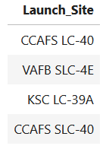
All Launch Site Names
Explanation:
● We see the names of the unique launch sites in the space mission

Slide 24
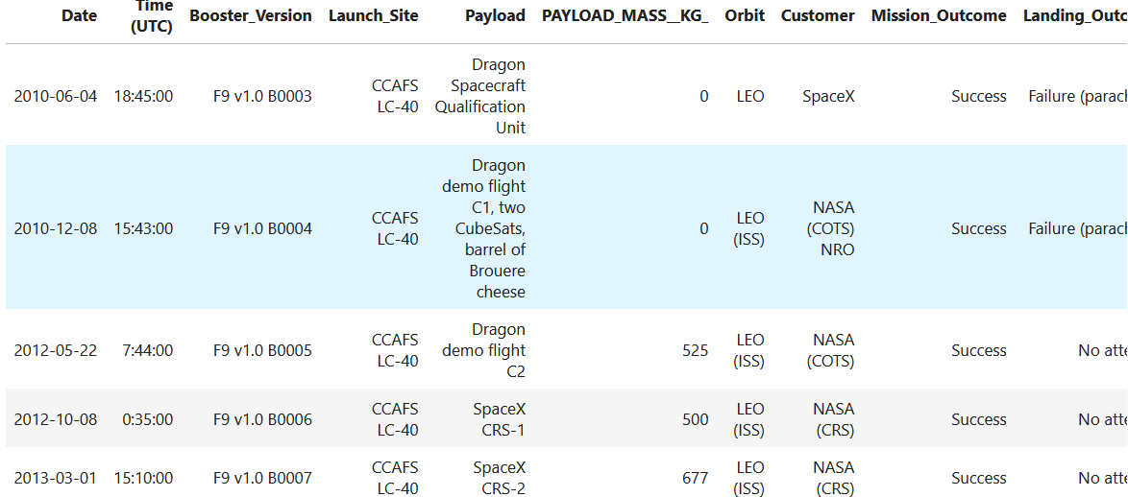
Launch Site Names Begin with 'CCA'
Explanation:
● We see ﬁrst 5 records where launch sites begin with the string 'CCA'

Slide 25
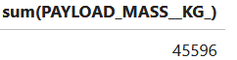
Total Payload Mass
Explanation:
● We see the total payload mass carried by boosters launched by NASA (CRS)

Slide 26
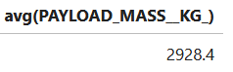
Average Payload Mass by F9 v1.1
Explanation:
● We see an average payload mass carried by booster version F9 v1.1

Slide 27
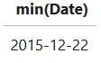
First Successful Ground Landing Date
Explanation:
● We see the date when the ﬁrst successful landing outcome in ground pad was achieved

Slide 28
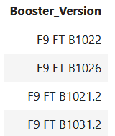
Successful Drone Ship Landing with Payload between 4000 and 6000
Explanation:
● We see the names of the boosters which have success in drone ship and have payload mass greater than 4000 but less than 6000

Slide 29
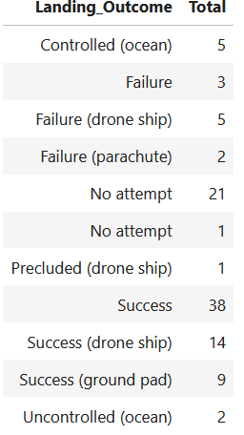
Total Number of Successful and Failure Mission Outcomes
Explanation:
● We see the total number of successful and
failure mission outcomes

Slide 30
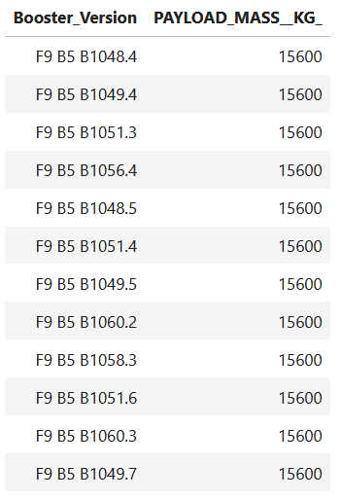
Boosters Carried Maximum Payload
Explanation:
● We see the names of the boosters which have
carried the maximum payload mass

Slide 31
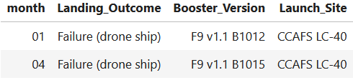
2015 Launch Records
Explanation:
We see the month names, failure landing_outcomes in drone ship ,booster versions, launch_site for the months in year 2015.

Slide 32
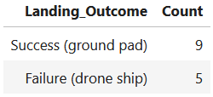
Rank Landing Outcomes Between 2010-06-04 and 2017-03-20
Explanation:
● We see the count of landing outcomes (such as Failure (drone ship) or Success (ground pad)) between the date 2010-06-04 and 2017-03-20, in descending order.

Slide 33

Section 3

Slide 34
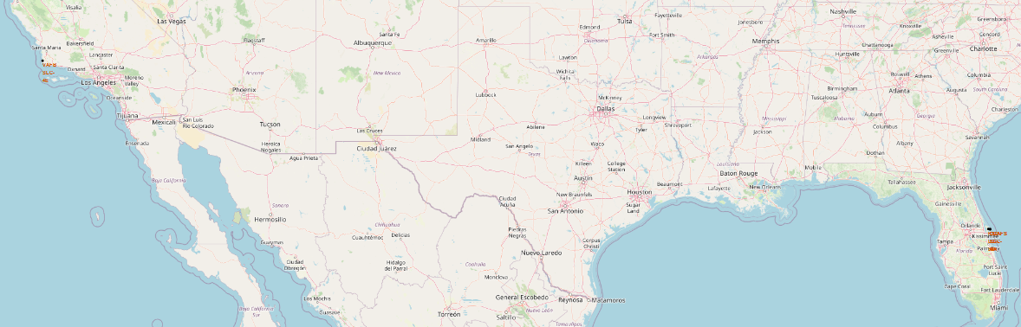
Map marked with launch sites
Explanation:
● All launch sites in proximity to the Equator line, because the Earth is moving faster at the equator than any other place on the surface. This speed helps the rockets keep up a good speed to stay in orbit
● All launch sites are very close to the coast, because it minimizes the risk of exploding near people

Slide 35
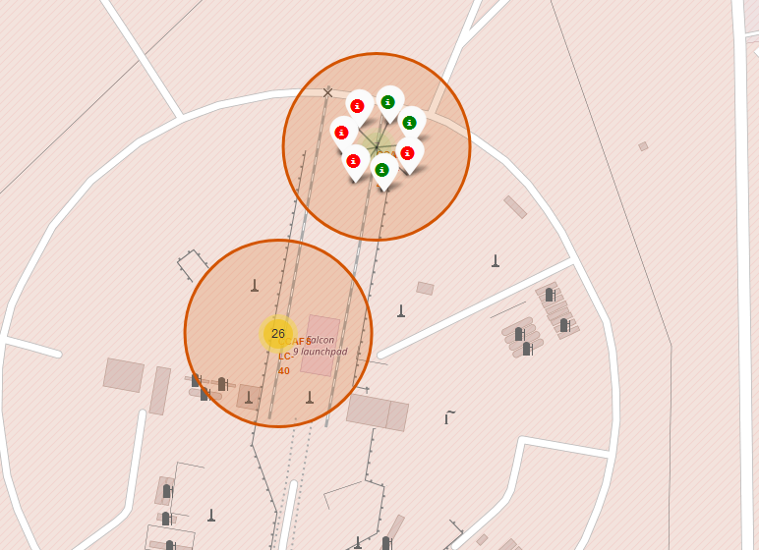
Color-labeled launches on the map
Explanation:
● All launch records are labeled into green or red
(where green is successful
launch and red - failure) markers, so we can easy
identify which launch sites have high success rates
● The map also shows the number of all launches
from each launch site

Slide 36
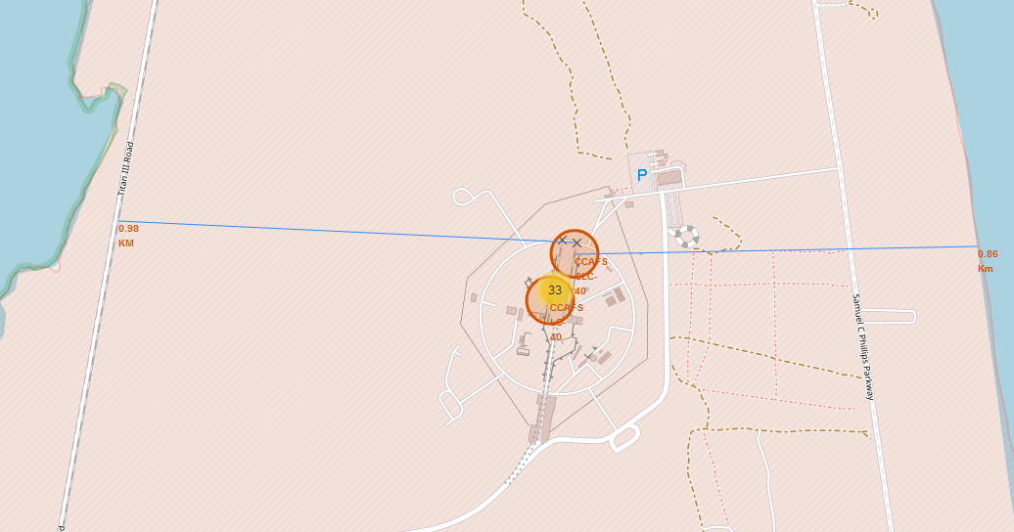
The distances between a launch site to its proximities
Explanation:
● For the launch site CCAFS SLC-40 we can
see that:
- distance to the nearest railway (0.98 km)
- distance to the nearest coastline (0.86 km)
● So this launch site is close to highway,
railway and coastline but the distance to
the nearest city is quite large

Slide 37

Section 4

Slide 38
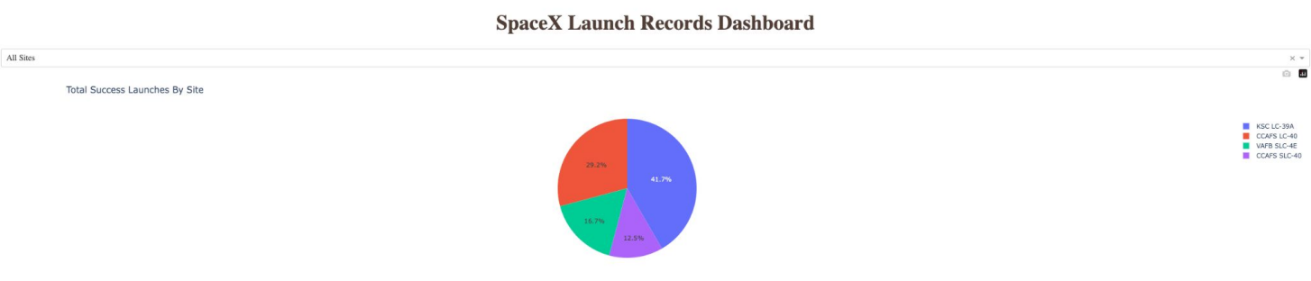
All sites launch success rate
Explanation:
● From the chart above we can get which launch sites are more successful
● So, we can see, that KSC LC-39A launch site has the highest number of successful launches (41.7%)

Slide 39
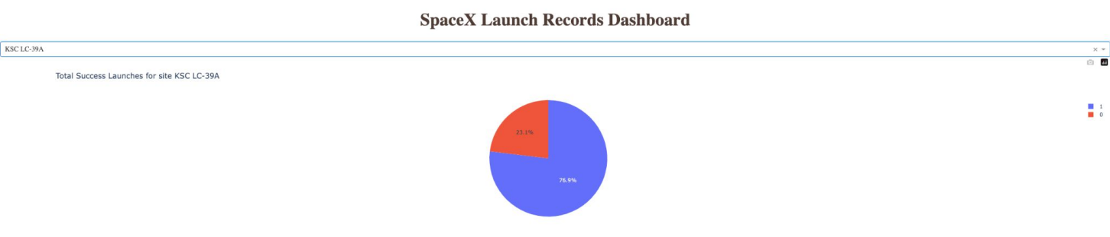
The highest success rate launch site
Explanation:
● The KSC LC-39A had a total of 13 launches, 10 were successful (76.9%) and only 3 failed (23.1%)

Slide 40
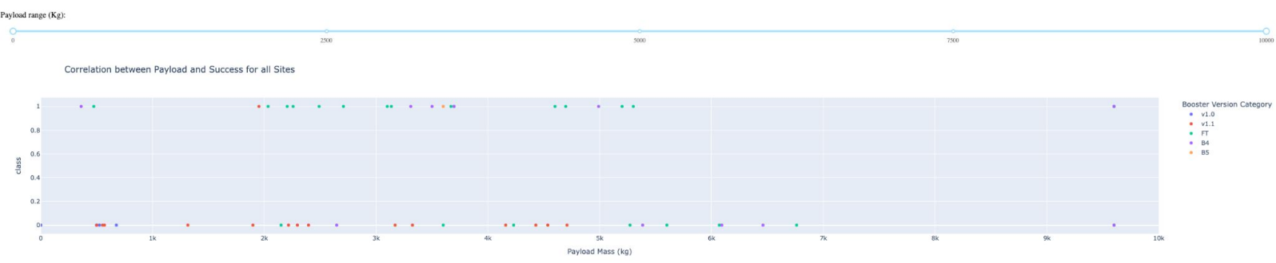
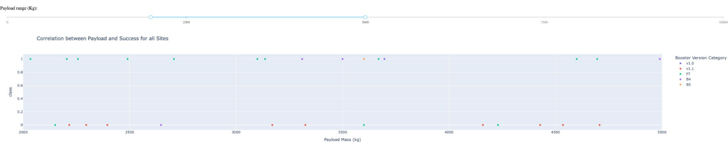
All sites Launch success vs Payload mass
Explanation:
● From the scatter charts we can easily identify that payloads between 2000 and 5500 kg have the highest success rate
● We also see which versions of boosters are more successful

Slide 41

Section 5

Slide 42
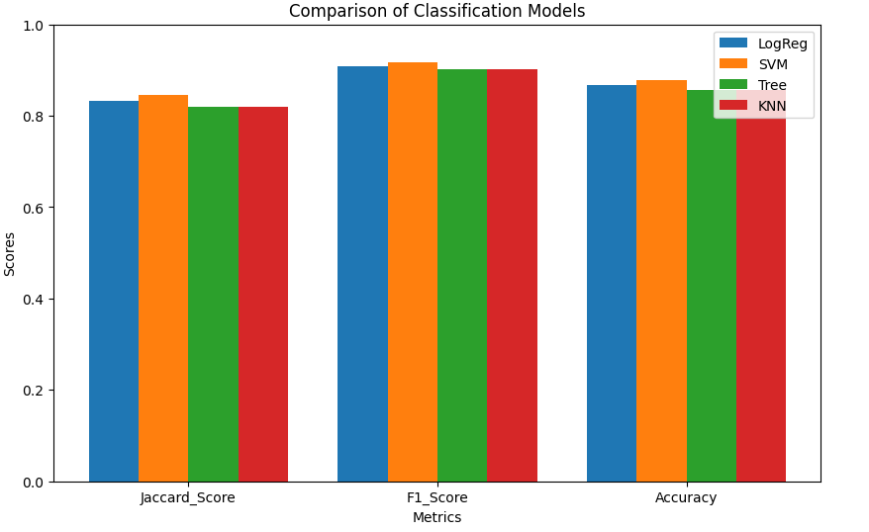
Classification Accuracy
Explanation:
● On the bar chart we can see that
SVM model (colored in orange) is the
best model with highest Jaccard score,
F1 score and Accuracy
● This scores is calculated for the
whole dataset, as the accuracy of each
classiﬁcation model is the same
on the test set (0.8333)

Slide 43
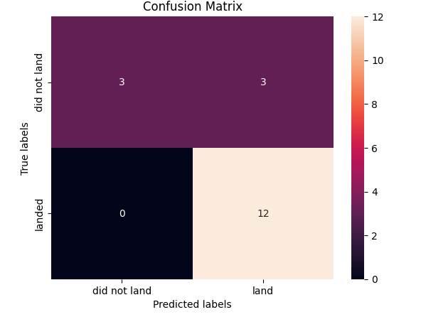
Confusion Matrix
Explanation:
● Examining the confusion matrix, we see that Support Vector Machine (SVM) model can distinguish between the different classes. We see that the major problem is false positives (FP)

Slide 44
Conclusions
• The Support Vector Machine (SVM) algorithm is the most effective machine learning classification method for this dataset. The model's accuracy and scores are high, allowing us to reliably predict the success of Falcon 9's first stage landing.
• Key factors influencing the success of Falcon 9's first stage landing include:
Payload Mass (kg): Launches with a lower payload mass achieve better outcomes
Orbit Type: Orbits such as ES-L1, GEO, HEO, and SSO boast a 100% success rate
Launch Site: KSC LC-39A exhibits the highest launch success rate

Slide 45
Appendix
A. Detailed Methods and Libraries
Algorithms and Models:
Support Vector Machine (SVM): Utilized with a linear kernel. The model showed the highest accuracy and prediction reliability for Falcon 9's first stage landing success.
Logistic Regression: Employed to predict binary outcomes. This model provided competitive but slightly lower performance compared to SVM.
Decision Tree: Used for its interpretability and ease of implementation. Though not the top performer, it offered insights into feature importance.
K-Nearest Neighbors (KNN): Selected for its simplicity. While effective, it was slightly less accurate than SVM and Logistic Regression.
Libraries:
Scikit-Learn: Version 0.24.2
Pandas: Version 1.3.3
NumPy: Version 1.21.2
Matplotlib: Version 3.4.3
Parameters:
For SVM, the regularization parameter C was set to 1.0.
For Logistic Regression, default parameters were used.
For Decision Tree, the max_depth parameter was set to 5.
For KNN, n_neighbors was set to 5.

Slide 46

B. Data Collection and Preprocessing
Data Sources:
The dataset was obtained from SpaceX’s open data portal, including details on launch outcomes, payload mass, orbit type,
and launch site.
Data Cleaning:
Missing values were handled using imputation techniques. Specifically, mean imputation was applied to numerical features.
Categorical variables were encoded using one-hot encoding to ensure compatibility with machine learning algorithms.
Feature Engineering:
Created new features such as Payload_Mass_Binned to categorize payload mass into discrete bins.
Encoded orbit types and launch sites into numerical values for model training.
C. Additional Tables and Visualizations
Accuracy Metrics:
The following table shows the accuracy, Jaccard score, and F1 score for each model:
Metric LogReg SVM Tree KNN
Jaccard_Score 0.833333 0.845070 0.819444 0.819444
F1_Score 0.909091 0.916031 0.900763 0.900763
Accuracy 0.866667 0.877778 0.855556 0.855556
Feature Importance:
Decision Tree feature importances highlighted Payload_Mass and Orbit_Type as critical features affecting launch success.

Slide 47
D. Additional Results and Discussion
Sensitivity Analysis:
Varying the C parameter in the SVM model showed minimal impact on accuracy, indicating robustness of the chosen parameter value.
Testing with different depths for the Decision Tree model confirmed that a maximum depth of 5 provided the best balance between bias and variance.
Alternative Models:
Attempts to use ensemble methods like Random Forest and Gradient Boosting showed comparable but not superior performance to SVM.
E. Technical Details
Software and Hardware:
Analysis performed on a machine with an Intel i7 processor and 16GB RAM.
All scripts were executed in a Jupyter Notebook environment running Python 3.8.

Slide 48


